Slide 1
Feast of St. Francis Prayer Service 2020
Notes:
FACILITATOR NOTE: Have slide up as people gather. Once it is time, welcome everyone, make any technology announcements, and before moving into prayer invite people to center themselves, catch their breath and enter into God’s presence.

Slide 2
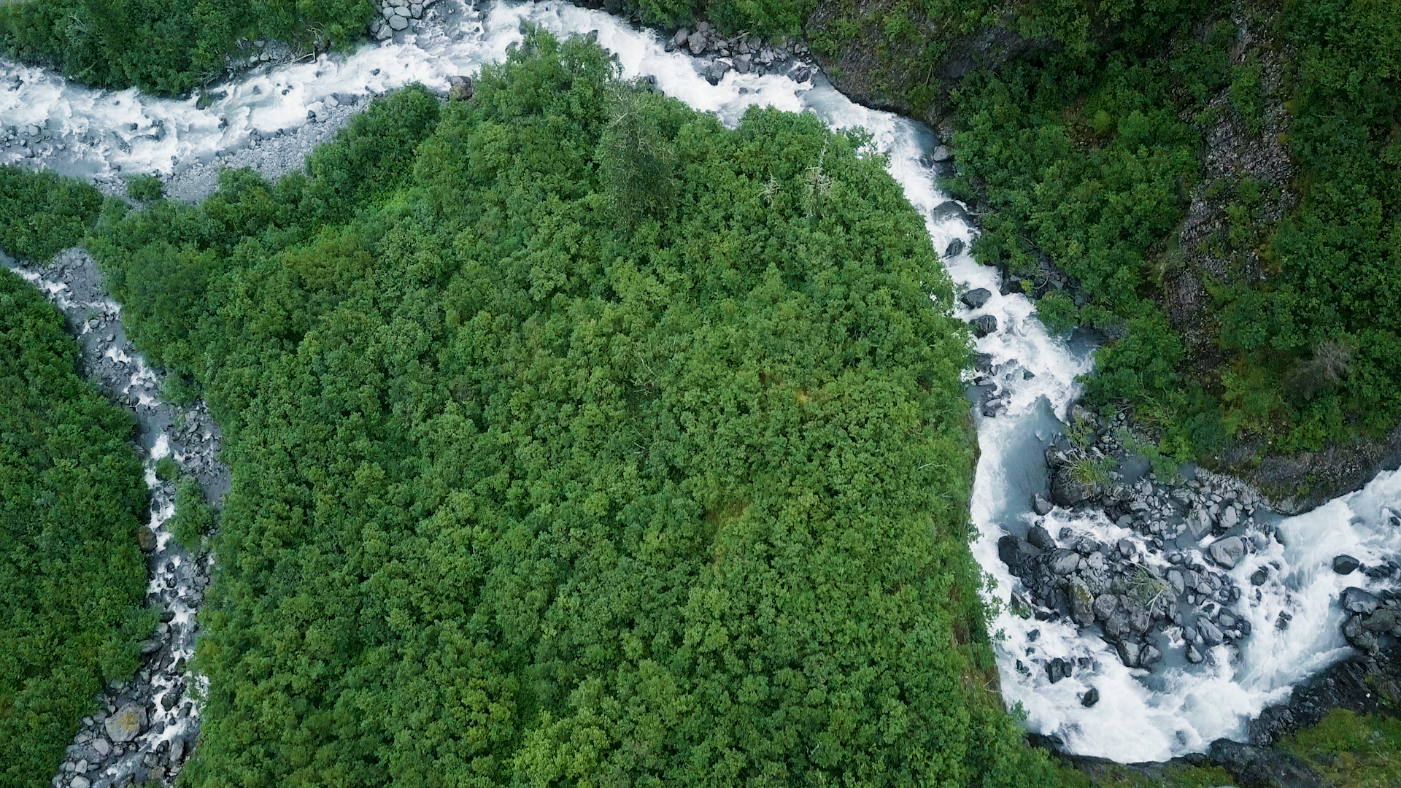
Notes:
READ: In a year where we have been clearly reminded of our interconnectedness and our responsibilities to one another, we cannot forget our interconnectedness and responsibility to creation – God’s good gift to us. Our care for the Earth is expressed largely in small things, commitments to change that may go unnoticed. And yet, Pope Francis reminds us, “There is a nobility in the duty to care for creation through little daily actions.”
Let us turn to scripture as we pray.

Slide 3
Notes:
READ: A reading from the Gospel of Matthew (Matthew 6: 25-30)
Therefore, I tell you, do not worry about your life, what you will eat [or drink], or about your body, what you will wear. Is not life more than food and the body more than clothing? Look at the birds in the sky; they do not sow or reap, they gather nothing into barns, yet your heavenly Father feeds them. Are not you more important than they? Can any of you by worrying add a single moment to your lifespan? Why are you anxious about clothes? Learn from the way the wildflowers grow. They do not work or spin. But I tell you that not even Solomon in all his splendor was clothed like one of them. If God so clothes the grass of the field, which grows today and is thrown into the oven tomorrow, will he not much more provide for you, O you of little faith?

Slide 4
Notes:
READ: When we pay attention, the Earth will teach us to understand harmony and balance, give and take. When we pay attention, we will be inspired again by the audacious hope of all green things. When we pay attention, we will understand God’s steadiness, constancy in change and the mysteries of becoming. When we pay attention, we will marvel at God’s unseen order – the interconnection of all living things. When we pay attention, we will know others to be our brothers and sisters, children of one common home. Let us pay attention to the earth and pray.

Slide 5
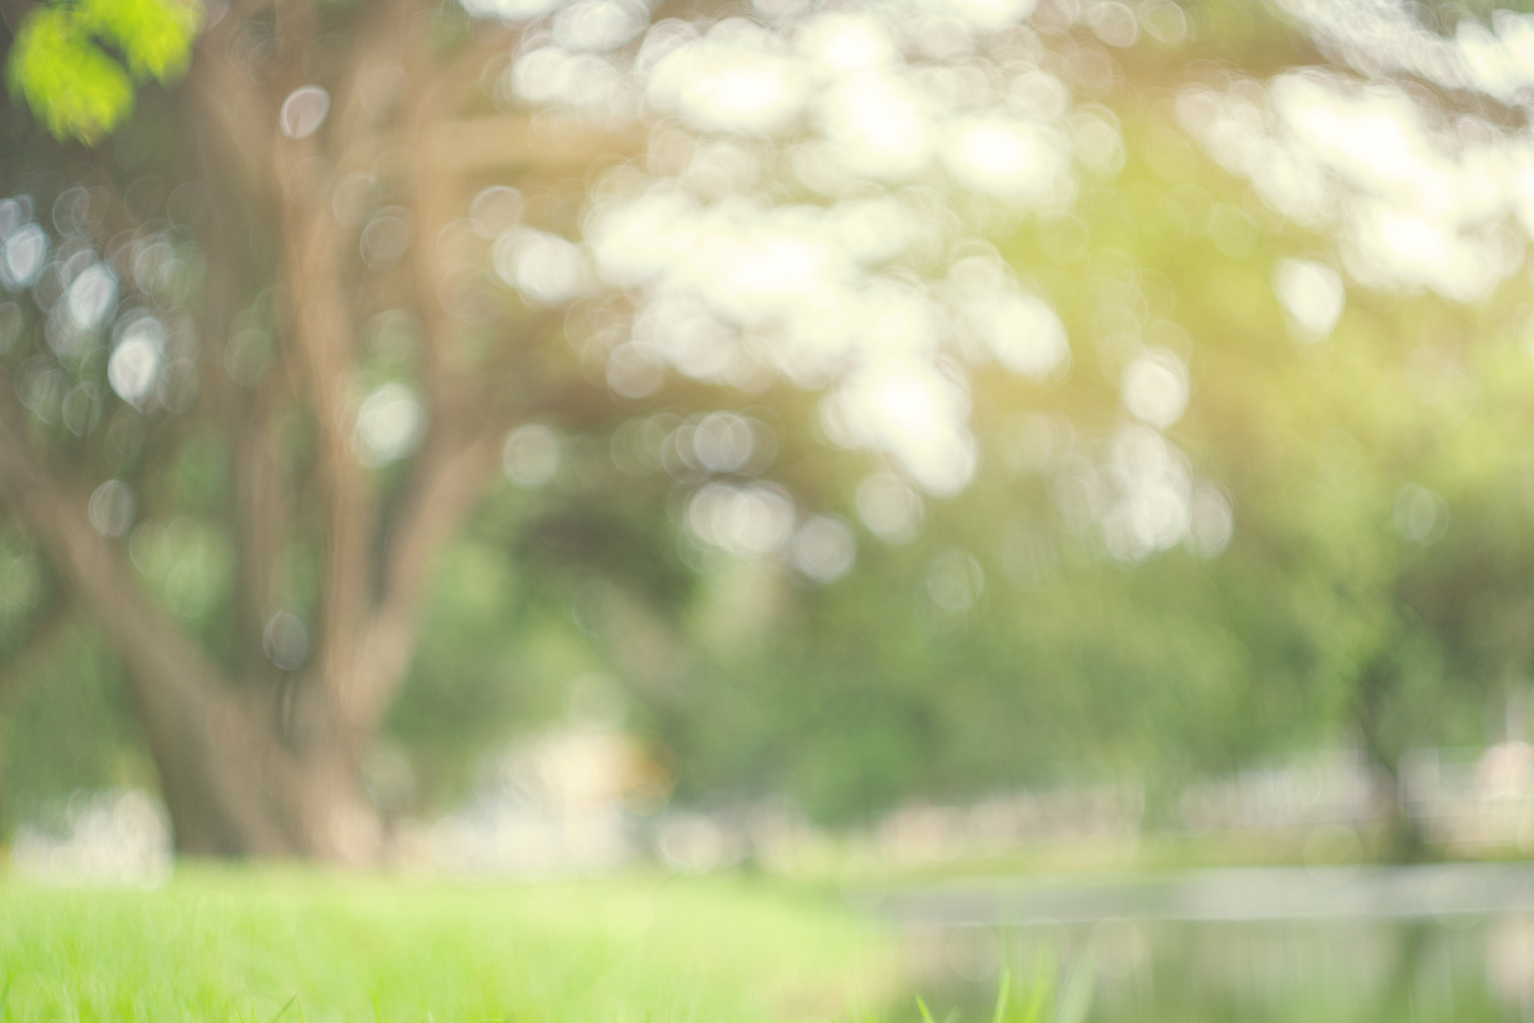
What lessons have you learned from the earth?
Notes:
FACILITATOR NOTE: You may allow for some silent personal reflection on this question at this time. If you would like some interaction this would be a place for participants to share their thoughts in the chat feature, go into breakout rooms, or if the group is manageable share aloud with others.

Slide 6
Notes:
FACILITATOR NOTE: Invite people to pray with you while remaining on mute.
God of all Creation, through your goodness you have given us the Earth as our home. We are grateful for all the wonders of the world which so clearly proclaim your glory. Teach us how to pay attention that we might learn from the natural world. Teach us how to care for each other as we care for creation. We ask these things through the intercession of Francis of Assisi and in the name of your Son, Jesus. Amen.

Slide 7
God of all Creation, through your goodness you have given us the Earth as our home. We are grateful for all the wonders of the world which so clearly proclaim your glory. Teach us how to pay attention that we might learn from the natural world. Teach us how to care for each other as we care for creation. We ask these things through the intercession of Francis of Assisi and in the name of your Son, Jesus. Amen.
Notes:
READ: Just as we each make our small offering to wear masks and maintain distance to care for others in this pandemic, we show our care for creation as we limit single use plastics, reduce water consumption, recycle diligently, plant trees, and walk gracefully on the land on which we live. The land which does not let us down.

