Slide 1
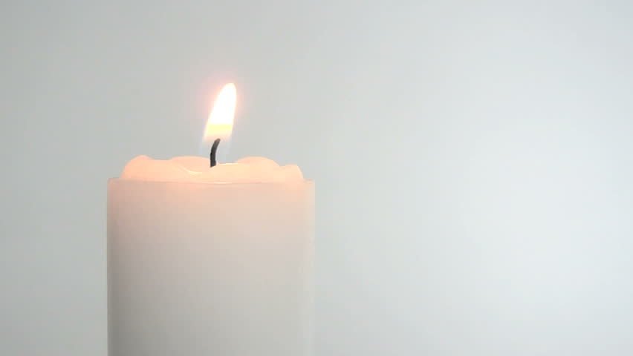
A Prayer for God’s Protection for All Caregivers During a Pandemic
© The Catholic Health Association of the United States

Slide 2
Opening
Let us be still in the presence of God and one another.
God calls each of us to a specific work; to make a contribution that only we can make. We pray today for the courage, skill and sacrifice of all caregivers serving in this time.
© The Catholic Health Association of the United States

Slide 3
Reading
Pillar of Cloud and Fire Exodus 13: 21-22
The Lord went in front of them in a pillar of cloud by day, to lead them along the way, and in a pillar of fire by night, to give them light, so that they might travel by day and by night. Neither the pillar of cloud by day nor the pillar of fire by night left its place in front of the people.
© The Catholic Health Association of the United States

Slide 4
Closing
Pray with me: God who traveled before and behind the Israelites in their journey from slavery to freedom, surround and support the men and women working in your healing ministry today. Never leave them, comfort them, and keep them well. Give them the strength to care for those who are sick and dying as well as the strength to receive help from others.
Be with their families of all who serve. Send your peace for their anxieties, joy for their fears, hope for their despair, and light for their darkness. We pray in the confidence of your love. Amen.

