Slide 1

God is Close: A reminder in the midst of global pandemic
© The Catholic Health Association of the United States

Slide 2
Leader
As our lives seem distant and disjointed, we remember that God is always close and in this divine closeness we are one no matter where we sit.
© The Catholic Health Association of the United States

Slide 3
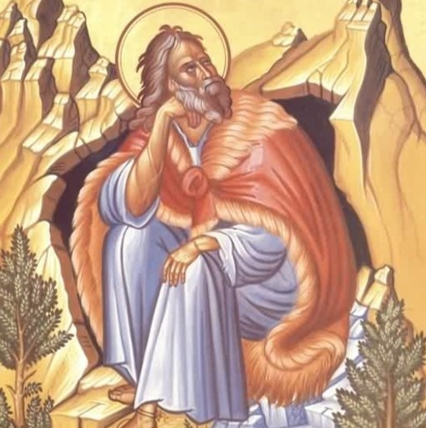
Reading
A reading from the first book of Kings
"And the word of the LORD came to [Elijah]: ‘What are you doing here, Elijah?’ He replied, ‘I have been very zealous for the LORD God Almighty. The Israelites have rejected your covenant, torn down your altars, and put your prophets to death with the sword. I am the only one left, and now they are trying to kill me too.’ The LORD said, ‘Go out and stand on the mountain in the presence of the LORD, for the LORD is about to pass by.’
Then a great and powerful wind tore the mountains apart and shattered the rocks before the LORD, but the LORD was not in the wind. After the wind there was an earthquake, but the LORD was not in the earthquake. After the earthquake came a fire, but the LORD was not in the fire. And after the fire came a gentle whisper. When Elijah heard it, he pulled his cloak over his face and went out and stood at the mouth of the cave. Then a voice said to him, ‘What are you doing here, Elijah?’”
1 Kings 19, NIV
© The Catholic Health Association of the United States

Slide 4
Reflection
We are living through a moment of deep disruption, chaos and anxiety. The things and people we hold most dear have been torn from us and the normal order of life has been utterly upended. The prophet Elijah was in a similar place. Rejected by his people, chased by his government, he was the last prophet in the land of Israel. Lonely and afraid, disconnected and heartbroken, Elijah waits for God.
© The Catholic Health Association of the United States

Slide 5
God does not arrive in wind. God does not arrive in an earthquake. God does not arrive in a fire. The creator of all is and was and is to come, is present in the gentle whisper.
God is in the gentle whisper. Though the wind rages, the earth shakes and fire scorches all we see, God will be there, close enough to whisper peace to our weary hearts.
As we navigate this pandemic, may we remember the absolute tenderness and perpetual closeness of God. In all the chaos and fear, God is always close enough that we can hear the divine whisper in our hearts.
© The Catholic Health Association of the United States

Slide 6
Closing
God of silence and stillness, we trust you are with us in this time of noise and chaos. We pray for an end to this pandemic. Whisper your words of comfort, encouragement, and hope to all who need them in these days of fear. Draw close to those who are sick and all those who risk illness caring for them, protect, and uplift them. In Your name, we pray. Amen.
© The Catholic Health Association of the United States

