Slide 1
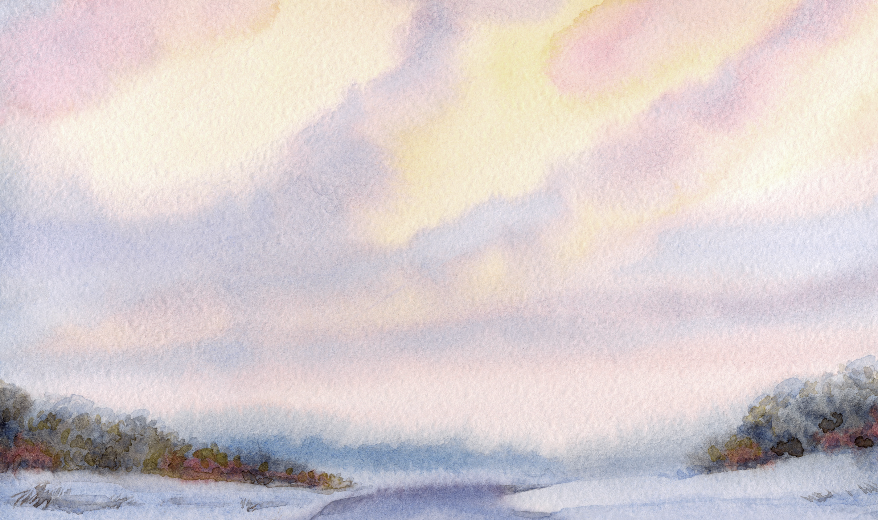
Great Spirit Prayer Translated by Lakota Sioux Chief Yellow Lark in 1887
Oh, Great Spirit, Whose voice I hear in the winds and whose breath gives life to all the world.
Hear me! I need your strength and wisdom.
Let me walk in beauty, and make my eyes ever hold the red and purple sunset.
Make my hands respect the things you have made and my ears sharp to hear your voice.
Make me wise so that I may understand the things you have taught my people.
Let me learn the lessons you have hidden in every leaf and rock.
Help me remain calm and strong in the face of all that comes towards me.
Help me find compassion without empathy overwhelming me.
I seek strength, not to be greater than my brother, but to fight my greatest enemy: myself.
Make me always ready to come to you with clean hands and straight eyes.
So when life fades, as the fading sunset, my spirit may come to you without shame.

